Slide 1
Social Influence Effects on Men's HIV Testing During a Randomized Controlled Intervention Trial in Tanzania
Thespina (Nina) Yamanis, Ph.D., MPH
Assistant Professor, School of International Service
Affiliate Faculty, Center on Health, Risk and Society
American University
Brian Aronson, Ph.D. Candidate
Sociology
Duke University

Slide 2
HIV testing among men in SSA
Men have low rates of HIV testing in sub-Saharan Africa (Shand et al, 2014)
Consequences include premature mortality and ongoing HIV transmission (Mills et al, 2011)
Men’s testing linked to success of HIV interventions with women (PMTCT)

Slide 3
Social networks and men
The theory of social influence postulates that individuals adopt behaviors they perceive as normative within their social networks in order to reinforce their sense of identity and belonging to the group
Studies show peer norms influence men’s sexual risk behaviors, including inconsistent condom use, early sexual debut, number of sexual partners, and having concurrent sexual partners
(Romer et al, 1994; Ali & Dwyer, 2009; Barrington et al, 2009; Yamanis et al, 2015)
Notes:
POINT OUT that most of these studies occur outside of SSA
Condom use: (Barrington et al., 2009; Blum, 2007; Rai et al., 2003; Romer et al., 1994),
Early sex debut: Maxwell, 2002
# sex partners: Ali & Dwyer, 2011
Concurrency: Yamanis

Slide 4
Study Purpose
To understand how social networks influenced changes in HIV testing behavior during an HIV prevention intervention trial with young Tanzanian men

Slide 5
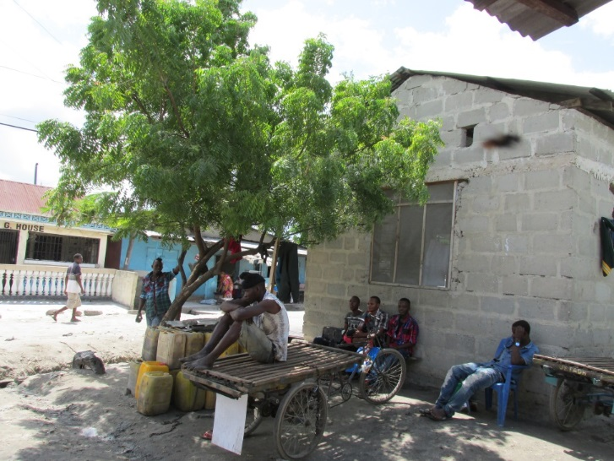
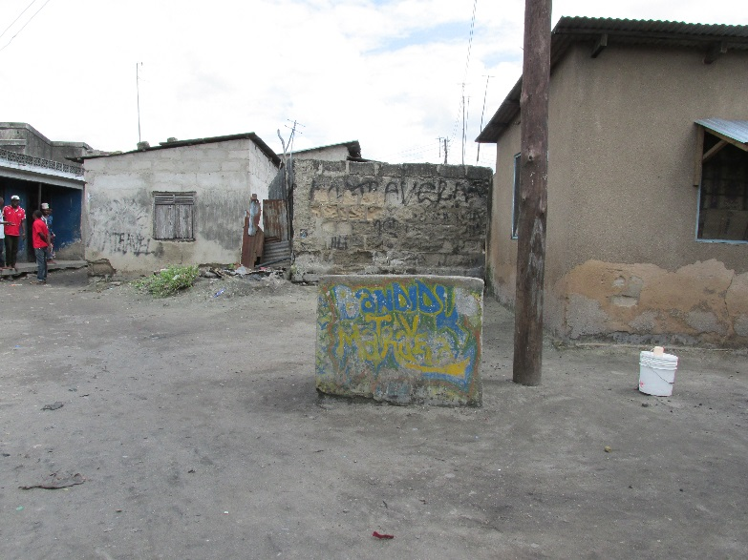
Young men’s venue-based social networks called “camps”
Stable venues (average existence = 8 years) and membership
Elected leadership (Chair, Secretary and Treasurer)
Average of 32 members, 85% of whom are male
Risk and protective features for HIV
Yamanis, Maman, Mbwambo, Earp & Kajula (2010). Social Science & Medicine.
Notes:
In our formative work, we learned that camps are naturally occurring social networks of mostly men. Camps are durable in that on average the camps we surveyed existed for 8 years. Camps are organized in that they have an elected leadership structure, with a chairperson, a secretary and a treasurer). Camps socialize in fixed locations like those depicted in the photos to the right. These are most often public open spaces, and sometimes they include enclosed structures.

Slide 6
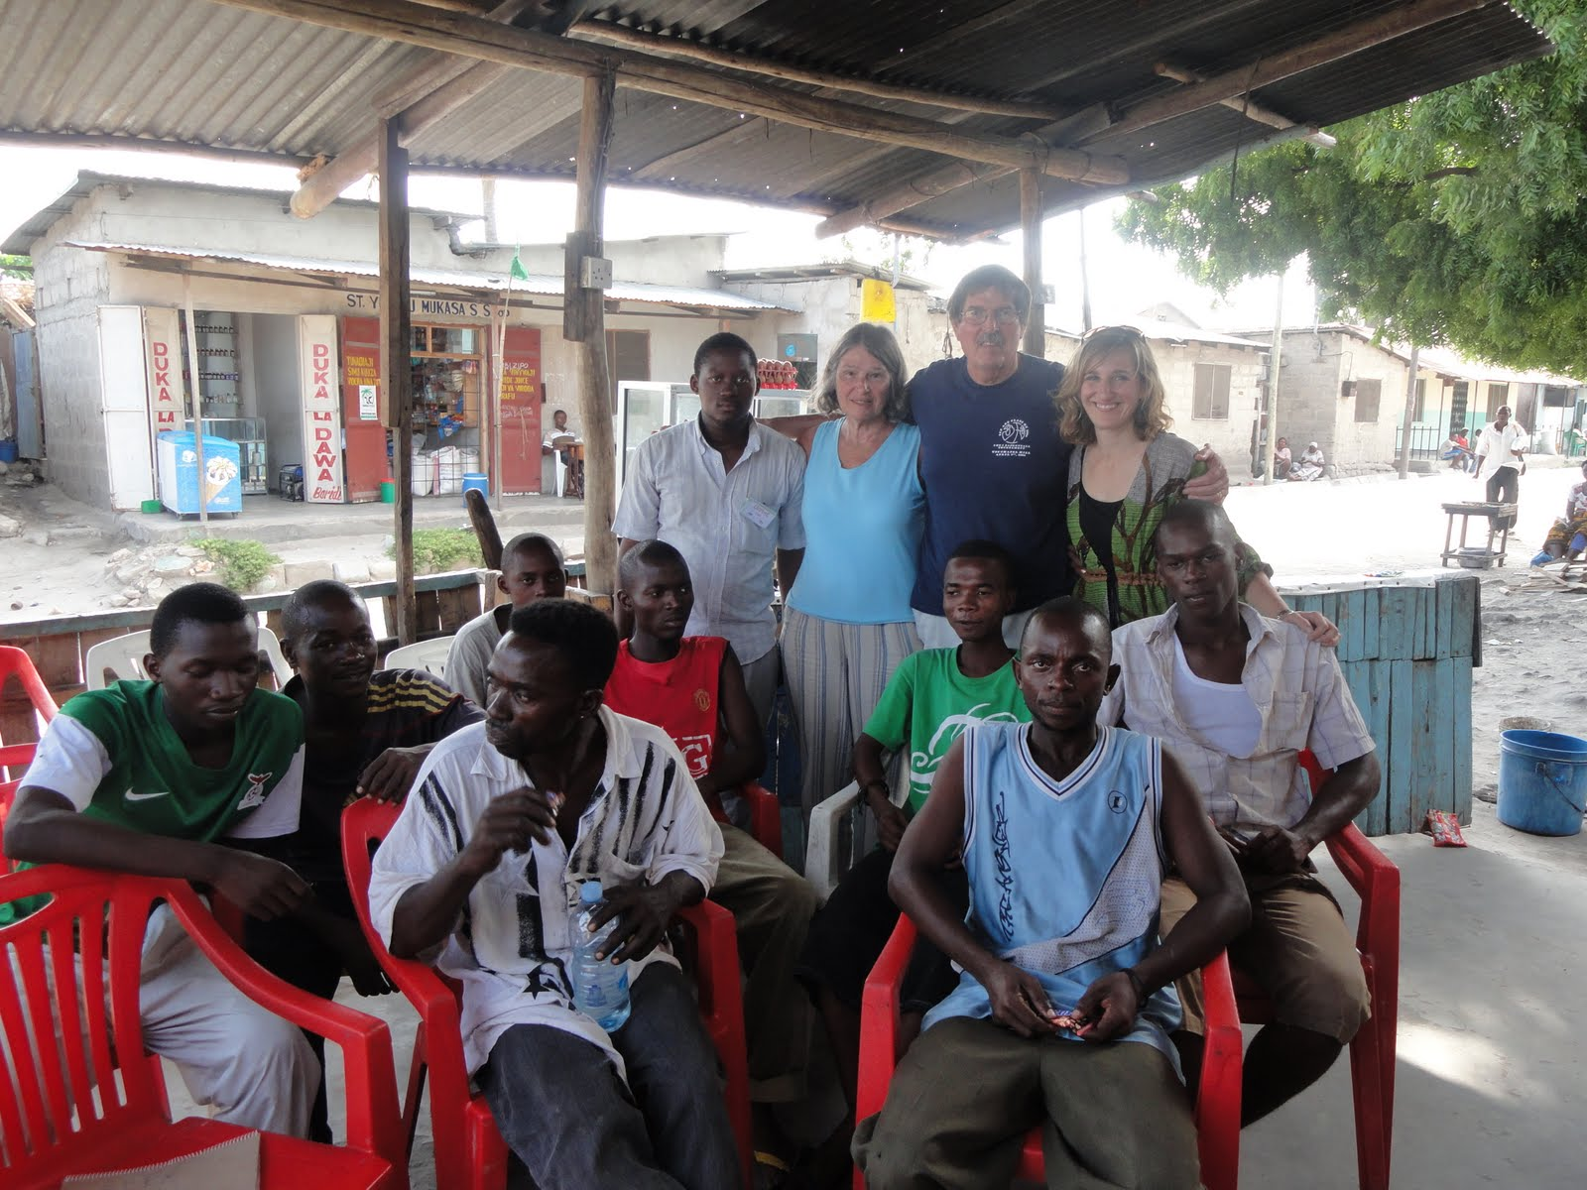

Slide 7
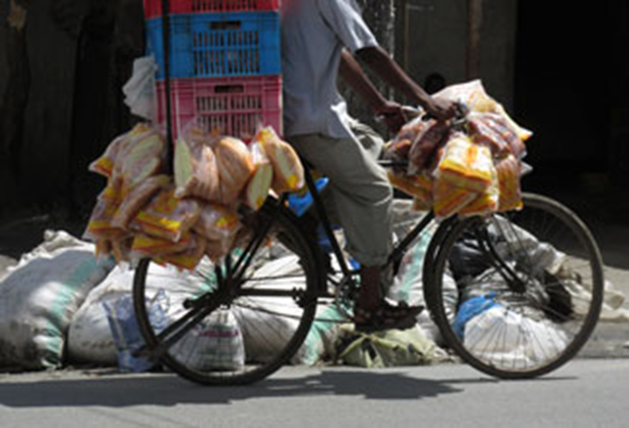
Microfinance and health intervention funded by NIMH (2012-2018)
Aim: To determine whether men in camps randomized to a microfinance and health leadership intervention have lower incidence of STIs and report perpetrating less IPV compared to men in control camps.
Mediators: HIV testing, acceptability of IPV
Research Design: Cluster RCT with 59 camps, 1249 men and 242 women
Kajula, Balvanz, Kilonzo, Mwikoko, Yamanis, Mulawa, Kajuna, Hill, Conserve, McNaughton Reyes, Maman (2016). BMC Public Health
Notes:
We launched the intervention trial in camps in 2012. The aim of the trial is to determine whether men in camps randomized to a microfinance and health leadership intervention have lower incidence of STIs and report perpetrating less IPV than men in camps randomized to control condition. The intervention is being evaluated through a cluster RCT design. We have enrolled 60 camps across the 4 wards, and half have been randomized to the intervention arm and half to the control. We enrolled over 1200 men across the 60 camps. We are assessing men at baseline, midline and endline. Baseline and endline assessments include both behavioral and biological assessments. The primary outcomes for the trial include STI incidence and IPV perpetration. The intervention that we are evaluating has two components that will run for 2 years.

Slide 8
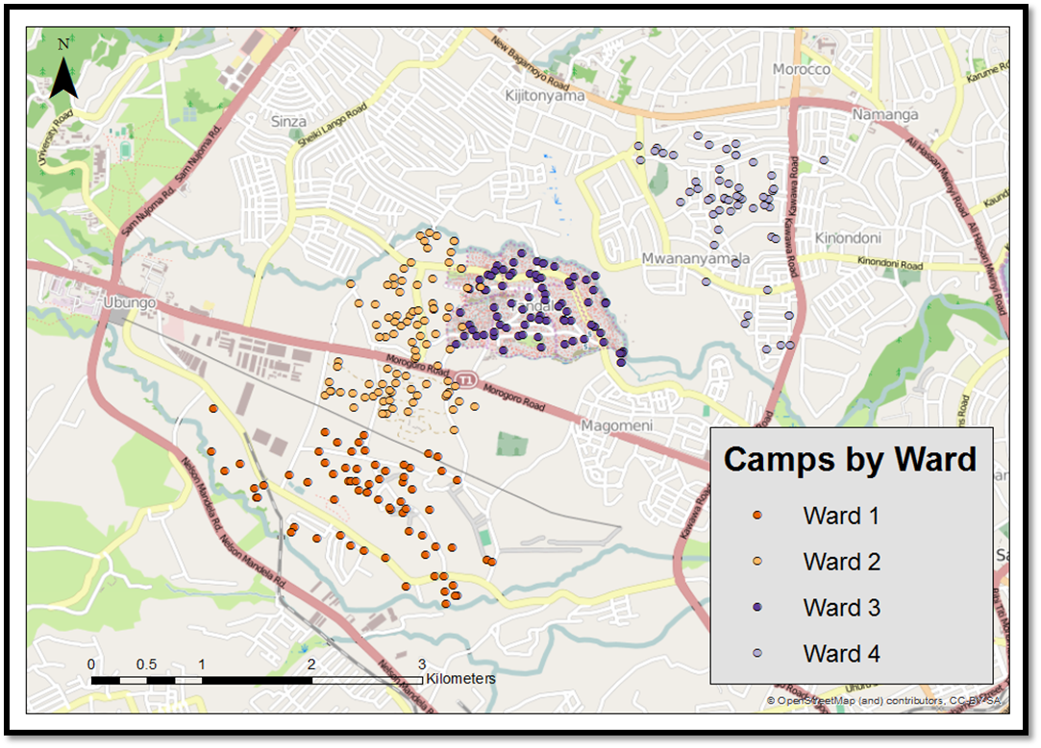
Identifying and selecting camps for trial
205 eligible camps: existed for 1+ years, 20-80 members, safe
Clustered contiguous camps and selected clusters using probability proportionate to size procedure
Selected simple random sample of 60 camps within clusters
Notes:
To evaluate the trial we randomly selected 60 camps from among the 205 that were mapped and met our eligibility criteria. The criteria included had to have existed for at least a year, had to have 20-80 members and had to be assessed as safe by our staff. Due to the population density in the wards where we are working, many fo the camps are located in close proximity to one another. We clustered contiguous camps using a probability proportionate to size procedure. We then selected a simple random sample of 60 camps within clusters and assigned them to intervention or control condition.

Slide 9
All camp members received assessments at three waves
Tablets with CAPI (computer-assisted personal interview)
Behavioral and social network assessments
Three waves: baseline, midline (12 months) & endline (30 months)
Biological assessments at baseline and endline
Dependent variables: “Have you ever tested for HIV?” and “Have you tested for HIV in the past 12 months?”

Slide 10
Social Network Data
Camp roster included first name, last name, nickname, age and gender for every camp member
Each name was read aloud by interviewer
The respondent was asked if he knew the person
For each known person, the respondent was asked whether the person was a friend, acquaintance, or someone didn’t get along with

Slide 11
Closest friends network
Each respondent was asked to identify their three closest friends from among the list of their friends in the camp.
For each of the two closest friends they were asked a series of questions:
Descriptive norms = “Do you think FRIEND 1 ever had an HIV test?”
Injunctive norms = “Do you think FRIEND 1 thinks that he/she should have an HIV test?”
Advice/advertisement= “Has FRIEND 1 encouraged you to get an HIV test?”

Slide 12
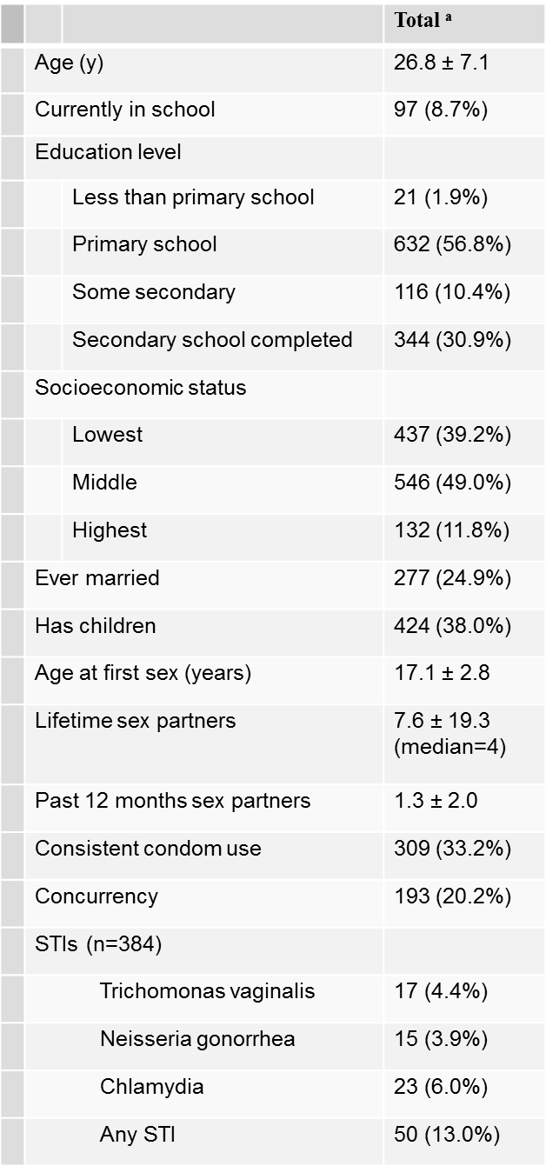
Descriptive statistics among baseline sample (n=1116) 52% of men had ever HIV tested at baseline.

Slide 13
Endline/Intervention Results
Among 1,249 men enrolled in the trial
978 (78.3%) men completed Wave 2 at 12-months
1,029 (82.4%) completed Wave 3 at 30-months
At Wave 3, men in the intervention condition reported greater levels of HIV testing than men in the control condition (aRR 1.13, 95% CI 1.00-1.28, p=.04)

Slide 14
Assessing Diffusion Effects on HIV testing
We want to assess whether changes in social norms for HIV testing influenced men to test over the life of the intervention, and which norms were most important for HIV testing.

Slide 15
Network Descriptive Stats
Wave | Density | Reciprocity | Transitivity | HIV Assortativity
1 | .0015 | .16 | .16 | .089
2 | .0019 | .22 | .24 | .085
3 | .0018 | .22 | .25 | .063
Network density, rate of transitivity, and rate of reciprocity are key selection effects controlled for in peer influence models
Good that these are fairly similar across waves. Don’t want the networks to change too much because it will crash the model.
HIV testing assortativity (homophily): the tendency for people to be friends with others who had their same HIV testing behavior was also not too high

Slide 16
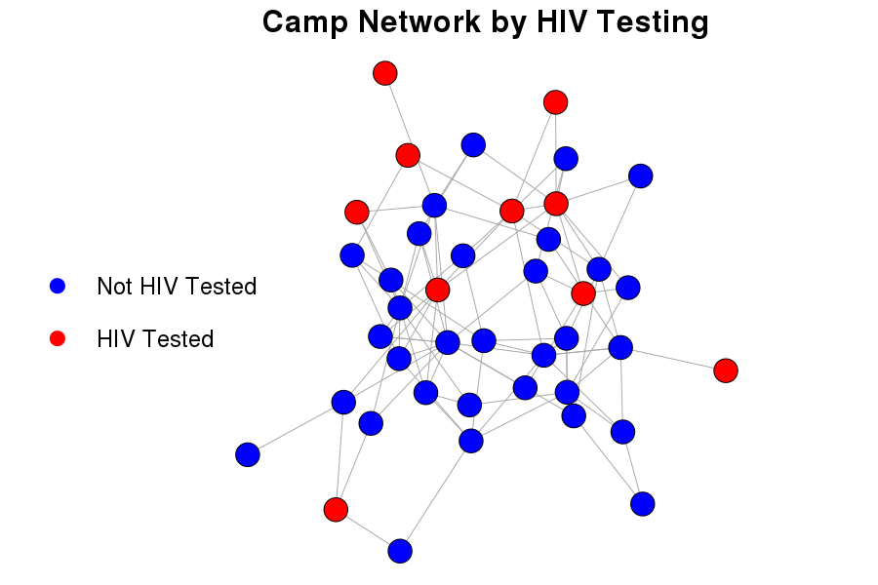
A camp with high HIV testing assortativity at Wave 1

Slide 17
Stochastic actor oriented model (SAOM) to estimate social influence on HIV testing from Wave 2 to Wave 3
Used RSiena to parse out whether the association between an individual’s behavior and his friend’s behavior is due to:
selection (people like to be friends with folks who are similar to them)
social influence (people like to be become more similar to their friends)
or some other endogenous factor (e.g. gender)
Notes:
e.g. if HIV testing and gender were associated, and people like to choose friends of the same gender, you might see an association between HIV testing and alter HIV testing).

Slide 18
Alter-level Norms: Egos Reports of Close Friend Alters
Variable name | Description | Coding
Alter-Tested | On average, does ego think his two close friend alters were tested? | 0 = neither friends 0.5 = ½ their friends 1 = both their friends
Alter-Should | On average, does ego think his close friend alters think ego should be tested?
Alter-Advertised | On average, does ego report that alters encouraged ego to get tested?
Tested Similarity | Average similarity between ego and alters’ HIV testing at Wave 2

Slide 19
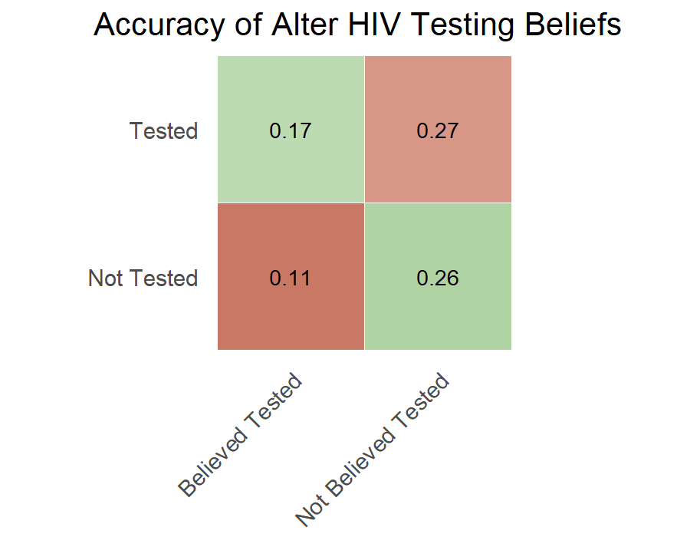
If ego correctly guessed if alter tested
Normative views can differ from reality!

Slide 20
Camp-level norms: Averaged at camp level
Variable name | Description
Camp-Test-Rate | What proportion of people in a camp were actually tested in past 12 months?
Camp-Tested | On average, do people in a camp think their friends were tested for HIV?
Camp-Should | What proportion of people in a camp think their alters think they should be tested?
Camp-Advertised | What proportion of people in a camp said their alters encouraged them to get tested?

Slide 21
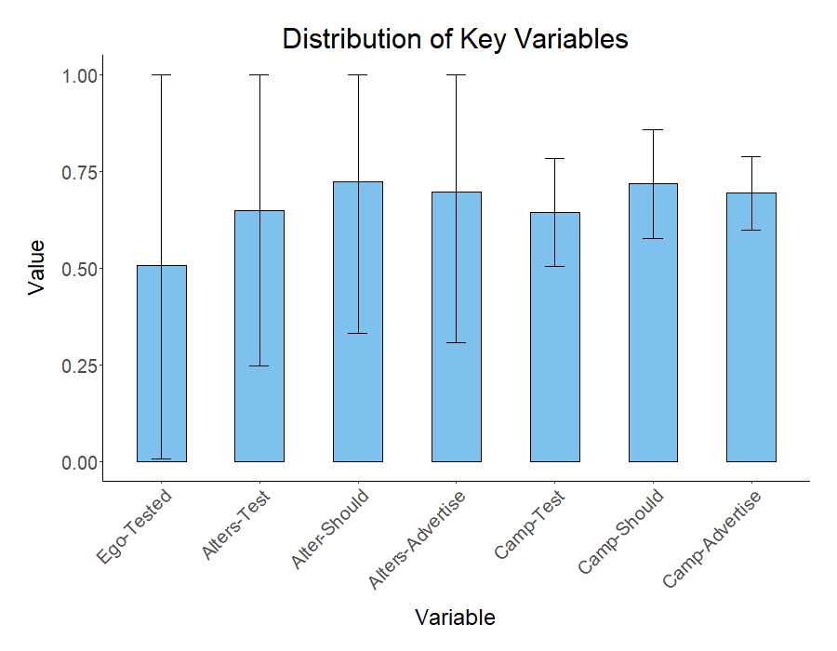
Picture of what data look like

Slide 22
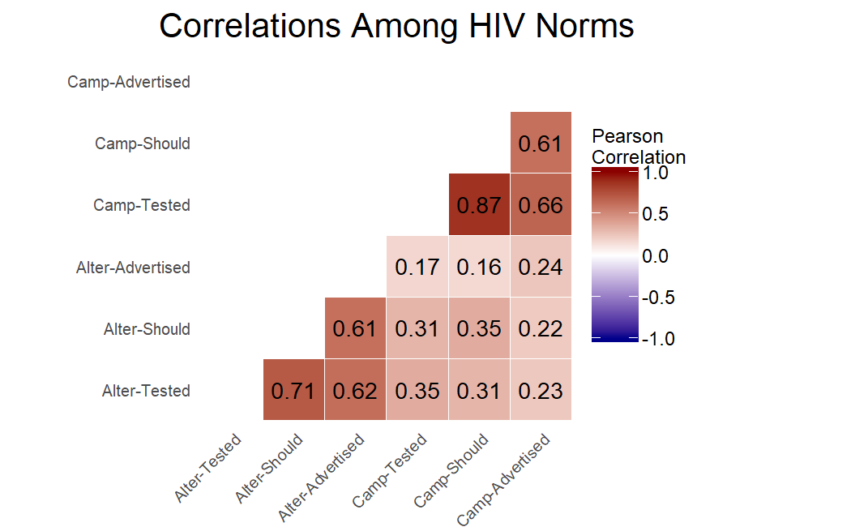
Camp-level and alter-level capturing different latent concepts

Slide 23
Fitting both parts of the Siena model
Fit the selection side of the model such that simulations of the network data produce friendship networks that closely match the observed network data in each following wave
Make sure the model converges to a consistent set of parameter estimates, and estimate a series of goodness of fit statistics to make sure the model fits the data
Estimate the behavior side of the model, with a series of increasingly complex models

Slide 24
Two Dependent variables in RSiena models
1. The friendship network
The model is trying to explain changes in friendships across waves.
Like a logistic model of tie prediction, predicting the odds of whether a person will nominate another person as a friend (with values 0= no, 1=yes).
2. The behavior data
The model estimates what factors influence a change in a reported behavior (in this case HIV testing).
Like a fixed effects framework

Slide 25
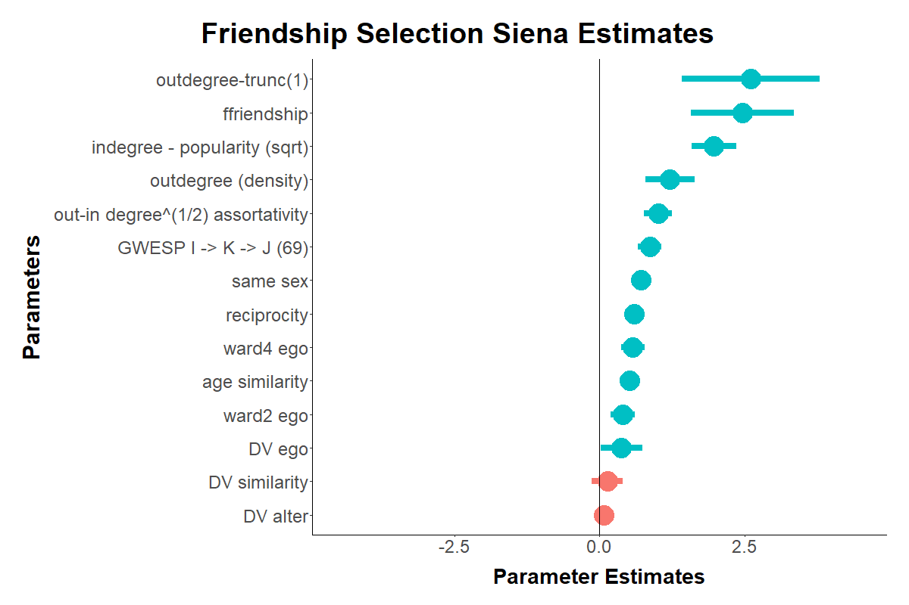
Rsiena model with 40 camps that had Jaccard >.15; dependent variable (DV) = HIV testing at Wave 3

Slide 26
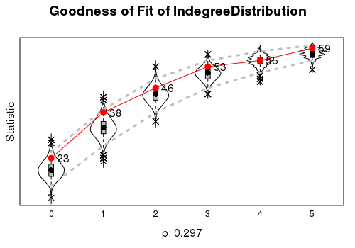
Goodness of Fit of Model – How well do simulations reflect true trends in data? Run across camps individually
Notes:
To repeat, the entire point of Siena models is to separate selection from influence effects; that is, to test whether our fixed effect models are simply picking up on whether people prefer to nominate alters who got tested for HIV when they themselves got tested for HIV. Our network function in the previous slide showed the our parameter estimates for the selection side of the Siena model. However, to determine its quality, we ran goodness of fit tests to see how well simulations based on our model estimates reflect true trends in the data. These were run across camps separately, and were generally very good.
Fig 5a shows the cumulative indegree distribution among respondents in our largest camp, specified by the red dots. For example, 23 respondents were not nominated by anyone, 38 were nominated by at most one person, etc. The violin plots behind them show indegree distributions drawn from our parameter estimates across 2000 simulations. Overall, the estimates are quite similar, indicating that our model closely captures the indegree distribution of the real data.

Slide 27
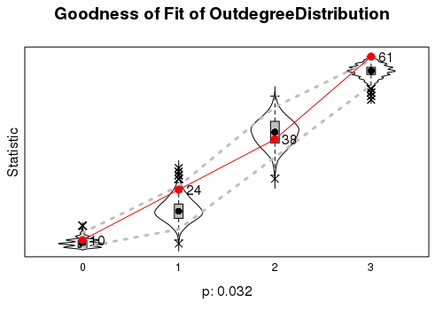
Notes:
Figure 5b shows something similar, indicating that the outdegree distribution of simulated data based on our model estimates are similar to those in the true data, and 5c shows that the geodesic distribution (i.e. how distant alters are typically from each and dense the network also matches the data). In other words, even though our model is predicting networks across a ton of different social settings, it's super good. Therefore, we can be confident that any effect we see on the behavioral side of the model is, in fact, measuring social influence."

Slide 28
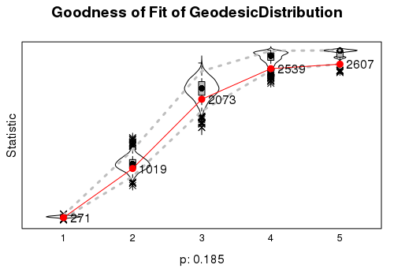

Slide 29
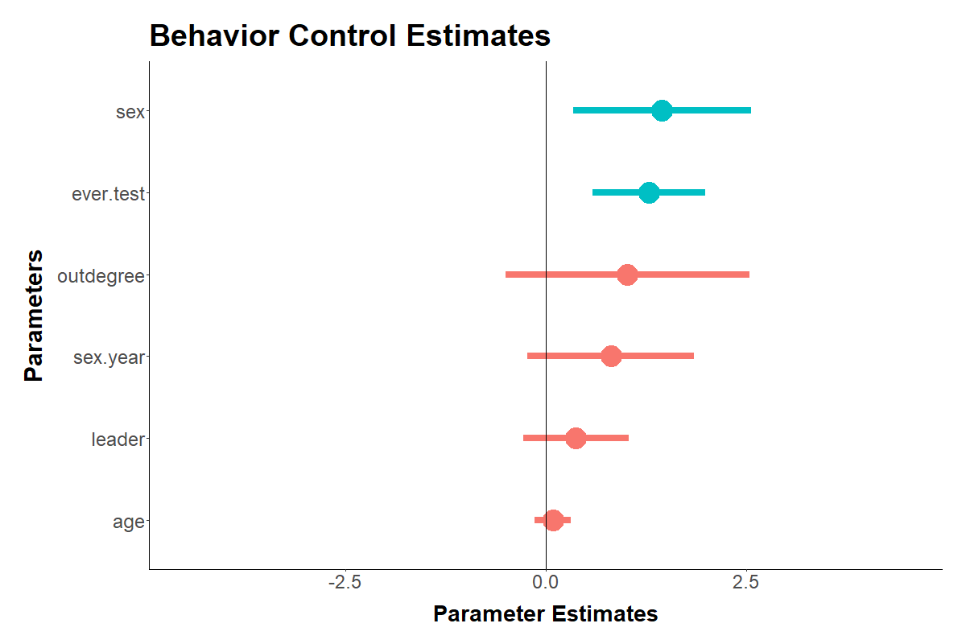
Control level variables

Slide 30
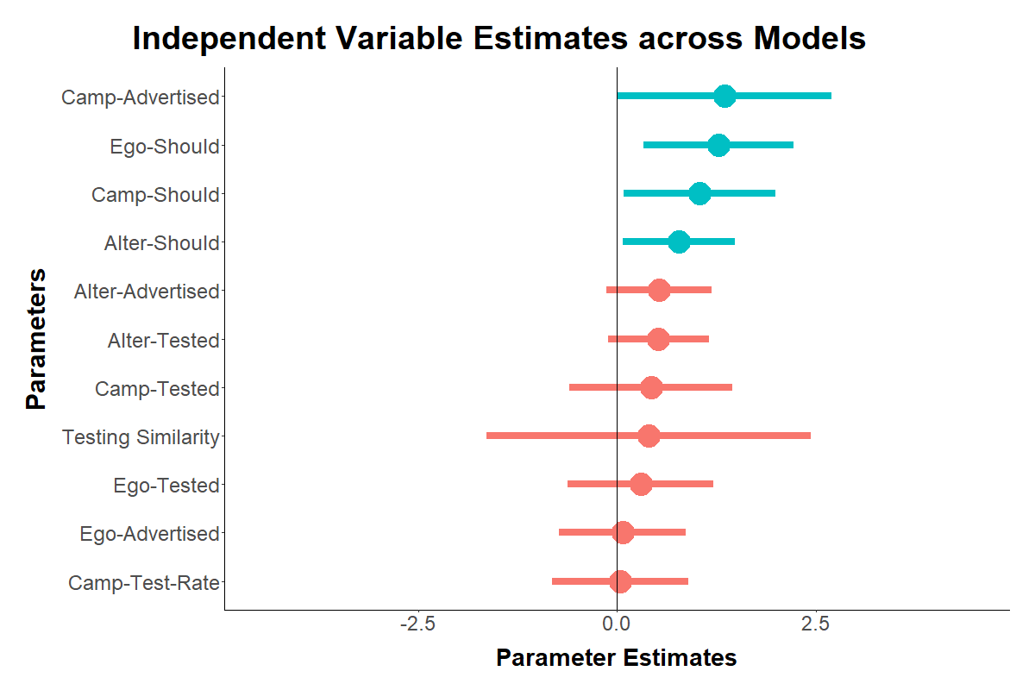
Influence Side of Model
Notes:
Generally, it looks like injunctive norms matter most for HIV testing. Interestingly, egos appear influenced to be both influenced by whether they think their alters think they should be tested (an-friendship based-normative effect), whether alters think that they think they should be tested (an expectancy effect), and by an overall camp sentiment about whether alters think people should be tested."

Slide 31
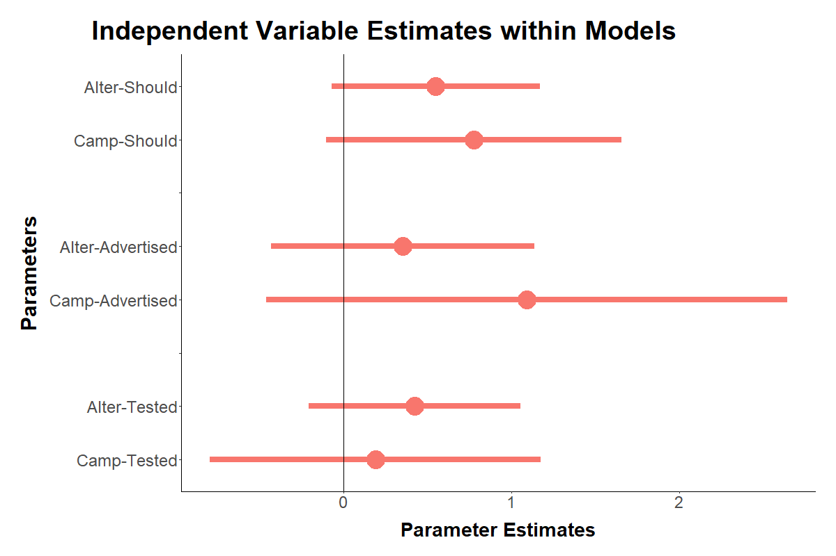
Insignificant, but similar size estimates in combined model with both alter and camp level norms
Notes:
Naturally, and as mentioned earlier, alter-level norms and camp-level norms are correlated. We wanted to know whether people are more influenced by norms of their alters or by norms across their entire social settings. We ran models, and found no significant effects for anything. However, the effect sizes for injunctive norms are only slightly lower than before. We believe a weakness of our model overall is statistical power. Statistical power is an issue for models that only use two waves of data from small social settings, so our current goal is to figure out how to better test these effects jointly and robustly

Slide 32
Acknowledgements
Duke Social Networks and Health Fellowship
National Institute of Mental Health, R01MH098690 (2012-2018), “A Multilevel Intervention to Reduce HIV Risk among Networks of Men in Tanzania” (Co-Investigator)
Marta Mulawa, James Moody and Suzanne Maman

Slide 33
Ahsante!
Email: yamanis@american.edu

Slide 34
RSiena models estimate network and behavior changes simultaneously
In economic modeling terms, it’s like trying to estimate the data generation process. You give the model the networks and behaviors at each time point, and a list of factors that you think influence changes in the networks and behaviors.
The model then plugs numbers into the model for each parameter you think influences changes in the network and behavior data simultaneously.
The model updates these numbers through a stochastic process, based on which numbers seem to replicate the observed data best.
These numbers represent the log odds that an individual will select a person as a friend (network data), or increase their rate of HIV testing (behavior data)

Slide 35
Q1245 | Do you think FRIEND 2 ever had an HIV test? | NO YES | 0 1 |  | E_HIVTSTF2
Q1246 | Do you think FRIEND 2 thinks that he/she should have an HIV test? | NO YES | 0 1 |  | E_HIVINJF2
Q1247 | Has FRIEND 2 encouraged you to get an HIV test? | NO YES | 0 1 |  | E_HIVADVF2

